Slide 1
Course Welcome
This course will introduce students to the Incident Command System (ICS). This system is used nationwide to manage incidents regardless of size or type.
This is the first in a series of ICS courses for all personnel involved in incident management. Descriptions and details about the other ICS courses in the series may be found on our web site: http://training.fema.gov.

Slide 2

Course Goal
The overall course goal is to promote effective response by:
Familiarizing you with the Incident Command System (ICS) and the NIMS principles used to manage incidents.
Preparing you to coordinate with response partners from all levels of government and the private sector.
IS-100.c provides information on ICS which is part of the National Incident Management System (NIMS). To learn more about NIMS following completion of this course, you can take IS-700.b: An Introduction to the National Incident Management System.

Slide 3

Overall Course Objectives
At the completion of this course, you should be able to:
Explain the principles and basic structure of the Incident Command System (ICS).
Describe the NIMS management characteristics that are the foundation of the ICS.
Describe the ICS functional areas and the roles of the Incident Commander and Command Staff.
Describe the General Staff roles within ICS.
Identify how NIMS management characteristics apply to ICS for a variety of roles and discipline areas.

Slide 4
Student Introductions
Introduce yourself by providing:
Your name
Your job title
A brief statement of your overall experience with emergency or incident response
Your possible roles in responding to incidents

Slide 5

Student Expectations
What do you expect to gain from this course?

Slide 6
Course Structure
The course is divided into the following five units:
Unit 1: Course Welcome and ICS Overview
Unit 2: NIMS Management Characteristics
Unit 3: ICS Functional Areas and Command Staff Roles
Unit 4: General Staff Roles
Unit 5: How ICS Applies to You

Slide 7
Course Logistics
Review the following information:
Course agenda
Sign-in sheet
Breaks
Message and telephone location
Cell phone policy
Facilities
Other concerns

Slide 8
Sample Agenda
Morning Session
Unit 1: Course Welcome and ICS Overview (1 hours)
Unit 2: NIMS Management Characteristics (1.5 hours)
Unit 3: ICS Functional Areas and Command Staff Roles (1 hour)
Afternoon Session
Unit 4: General Staff Roles (1 hour)
Unit 5: How ICS Applies to You (1 hour)
Final Exam (1 hour)

Slide 9
Course Completion
In order to successfully complete this course, you must:
Participate in unit activities.
Achieve 75% or higher on the final exam.
Complete the end-of-course evaluation.

Slide 10
Unit 1: ICS Overview
Unit 1 provides an overview of the Incident Command System (ICS). At the end of this lesson, you should be able to:
Describe the Whole Community approach to ICS.
Identify the basic concept and benefits of ICS.

Slide 11
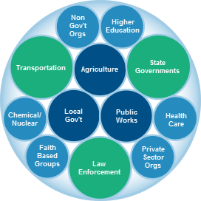
Whole Community
Every part of society must be involved in preparing for, protecting against, responding to, recovering from, and mitigating any and all incidents. The Federal Government is only one part of the whole community.
The Whole Community approach ensures solutions that serve the entire community are implemented, while simultaneously making sure that the resources the different members of the community bring to the table are used efficiently. These members include those in all levels of government as well as those in non-governmental and private-sector organizations in fields such as transportation, health care, schools, public works, communications, agriculture, chemical/nuclear, and more.

Slide 12

What is the Incident Command System?
The Incident Command System (ICS) is a standardized approach to incident management that:
Is used for all kinds of incidents by all types of organizations and at all levels of government; ICS is applicable to small incidents as well as large and complex ones.
Can be used not only for emergencies, but also for planned events.
Enables a coordinated response among various jurisdictions and agencies.
Establishes common processes for incident-level planning and resource management.
Allows for the integration of resources (such as facilities, equipment, personnel) within a common organizational structure.

Slide 13

When is ICS Used?
The Incident Command System (ICS) can be used to manage any type of incident, including a planned event (e.g., the Olympics, the Governor's inauguration, state fairs, a local parade, etc.). The use of ICS is applicable to all types of incidents, regardless of their size or cause.
As a system, ICS is extremely useful. Not only does it provide an organizational structure for incident management, but it also guides the process for planning, building, and adapting that structure.
Using ICS for every incident or planned event provides the practice that will help to maintain and improve skills needed to effectively coordinate larger or more complex efforts.

Slide 14
ICS for Planned Events
From your own experiences, what are some examples of different types of planned events where ICS was used?
Why was it beneficial to use ICS?

Slide 15

Incident Command System: Promoting Response Partnerships

Slide 16
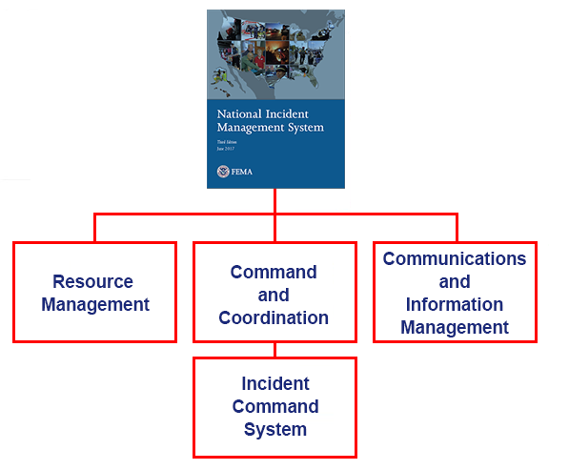
ICS as a Component of the National Incident Management System (NIMS)
The National Incident Management System (NIMS) is a systematic, proactive approach to guide all levels of government, nongovernmental organizations (NGOs), and the private sector to work together to prevent, protect against, mitigate, respond to, and recover from the effects of incidents. NIMS provides a consistent foundation for all incidents, ranging from daily occurrences to incidents requiring a coordinated Federal response.
NIMS is organized into three major components:
Resource Management
Command and Coordination - including the Incident Command System
Communications and Information Management
It is important to note that the Incident Command System (ICS) is just one part of NIMS.

Slide 17
Incident Response Problems
What are some common causes of incident response problems?

Slide 18
ICS Benefits - Student Activity
Activity Purpose: The purpose of this activity is to discuss the benefits of ICS.
Instructions: Follow the steps below to conduct this activity:
Divide into groups of five or six.
Work as a team to review the scenario presented below.
Identify the top three challenges for officials to manage this incident.
Write the challenges on chart paper.
Discuss how ICS could be used to address these challenges.
Select a spokesperson.
Time: 20 minutes (including debrief)
Scenario:
Continuing severe weather is causing widespread damage. There are multiple impacts in the community. Vehicle movement is constrained, some people are stranded and are in need of assistance, there have been impacts on communications and power, and some structures are impacted. 9-1-1 operators are receiving conflicting reports about a number of life-safety needs, including some weather-related injuries and an unverified report of the structural collapse of an assisted living facility.

Slide 19
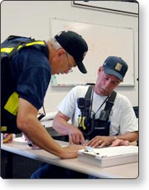
Benefits of ICS
The Incident Command System (ICS) has positively impacted incident management efforts by:
Clarifying chain of command and supervision responsibilities to improve accountability.
Leveraging interoperable communications systems and plain language to improve communications.
Providing an orderly, systematic planning process.
Implementing a common, flexible, predesigned management structure.
Fostering cooperation between different disciplines and agencies.

Slide 20
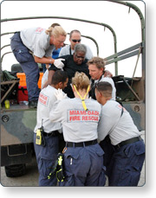
ICS: Built on Best Practices
The Incident Command System (ICS) has been tested for more than 40 years of emergency and nonemergency applications by all levels of government; and in nongovernmental and private-sector organizations. ICS helps to ensure:
The safety of responders, community members, and others.
The achievement of incident objectives.
The efficient use of resources.

Slide 21
Review Questions
Let's review what you have learned in this Unit:
What is a basic definition of the Incident Command System?
Is it the same as NIMS?
What are some situations for which it can be used?

Slide 22
Unit 1 Summary
You have completed the Course Welcome and Incident Command System (ICS) Overview unit. This unit presented the following key points:
ICS is a standardized management tool that allows better coordination and use of resources.
ICS represents organizational best practices and has become the standard for emergency management.
ICS can be used to manage the response for all incidents and planned events.
ICS works! It saves lives!

